Slide 1

Satellite Remote Sensing of Coastal Waters: Selected Needs & CREST Responses
Sam Ahmed, Alex Gilerson, Soe Hlaing, Ioannis Ioannou
Optical Remote Sensing Laboratory,
The City College of the City University of New York,
NOAA CREST
CREST Symposium, June 5, 2013

Slide 2
CREST Researchers & Students:
Multidisciplinary Group at CCNY & UPRM
CCNY
Electrical Engineering - Optical Remote Sensing Laboratory: Professors: S. Ahmed (Lead, Herbert Kayser Chair Professor) A. Gilerson, F. Moshary, B. Gross
Postdocs: I. Ioannou, S. Hlaing, S. Tiwari, Y. Gu
Civil Engineering: Professor: H. Tang
Computer Science: Professors: I. Gladkova, M. Grossberg
UPRM
Department of Marine Sciences, Bio-Optical Oceanography Laboratory: Professor: R. Armstrong
CCNY and UPRM students:
Grad Students: A. Ibrahim, C. Carrizo, A. El-Habashi, R. Foster, D. Lado, K. Qu, H. Li, S. Kraatz, F. Shahriar (CCNY) , N. Hernández (UPRM)
Undergrad Students:, K. Bastani, R. Hussain (CCNY)

Slide 3
Main NOAA & Other Collaborators:
NESDIS/STAR: Drs. Menghua Wang, Paul DiGiacomo, Mike Ondrusek, Chris Brown, A. Strong (Coral Reef Watch)
NOS: Drs. Rick Stumpf, Robert Warner
NASA: Drs. Brian Cairns, Jacek Chowdhary, Mike Mishchenko, Maria Tzortziou
NRL: Drs. Alan Weideman, Weilin Hou, Ruhul Amin, (Stennis), Deric Gray, Jeffrey Bowles (Washington, DC)
Universities: Drs Robert Arnone, Southern Miss, Z.P. Lee U Mass, Boston, Curt Davis, Oregon State, Alex Chekalyuk, Columbia University
Regional Authorities: Drs Vince Loveco, Mote Marine Labs, HABs, James Ivey, Florida Fish & Wildlife
Industry: Drs. Jeffrey Puschell (Raytheon), Mike Twardowski (WET Labs)

Slide 4
CREST Theme IV Science Goals
Improve Satellite Retrievals of Inherent Optical Properties and Qualities of Coastal & Oceanic Waters
Focus on Coastal Waters:
that is where populations & economic & commercial interests are concentrated
satellite retrievals in Coastal Waters are challenged and need great improvements to be practically useful.

Slide 5
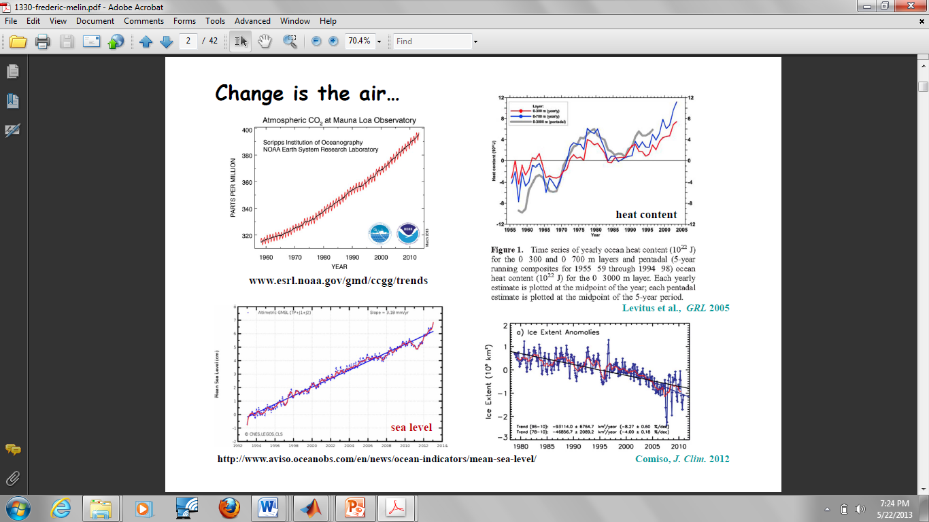
Melin, 2013

Slide 6
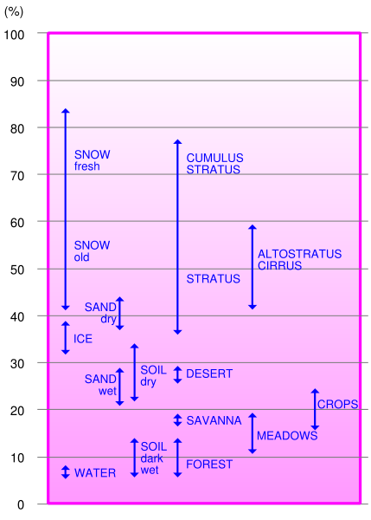
Reflectance of Various Surfaces
Signal from water is small in comparison with reflectance from other surfaces and atmosphere

Slide 7
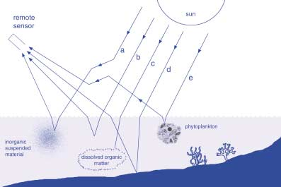
Water Composition for the Open Ocean and Coastal Waters
In the open ocean algae are the main component
In coastal waters algae are mixed with CDOM and minerals
Algae CDOM* Minerals
*CDOM is the colored dissolved organic matter mostly of terrestrial origin

Slide 8
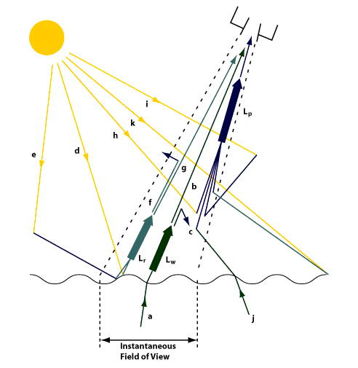
Total Radiance Signal at the Top of Atmosphere
L_{p}
L_{s}
L_{w}
L_{w} -Total water-leaving radiance. L_{s} - Radiance above the sea surface due to all surface reflection effects within the IFOV. L_{p} - Atmospheric path radiance.
Signal from the atmospheric scattering is about 10 times stronger than from water.
Atmospheric correction utilizes NIR bands (748, 865 nm)

Slide 9
Main Requirements for Climatic Data Records
To gain insight into climate variability and change the requirement is continuous time series of observations to estimate ocean properties such as phytoplankton chlorophyll-a with the radiometric accuracy of current sensors or better (IOCCG report 13)
Length: relevant for climate time scales (referred to as “long-term”) need for multiple decades of data (>~50 years) - Melin, 2013
Two levels of products
- Water leaving radiance / Remote sensing reflectance (Rrs) – highly accurate measurements by well calibrated sensors and consistency through various missions
- Chlorophyll-a concentration (Chla) – main ocean color product – continuous time series

Slide 10
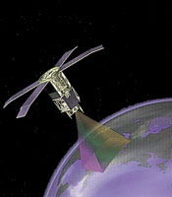

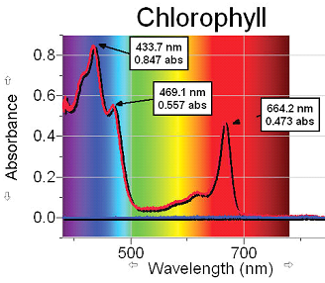
Remote Sensing of the Ocean
RS of water areas provides an efficient way of monitoring water quality, biomass in the ocean, sediment plumes, spatial and temporal scales of the water structures, sea surface temperature, etc.
Phytoplankton are very
important part of ocean life:
Phytoplankton are the first link in the food chain.
Phytoplankton convert nutrients into plant material by using sunlight through photosynthesis and convert carbon dioxide from sea water into organic carbon and oxygen as a by-product and thus affect carbon balance.
Amount of phytoplankton in the ocean can be traced by the concentration of the optically active pigment chlorophyll [Chl]

Slide 11
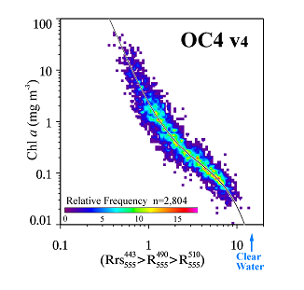
Reflectance spectra for the open ocean
[Chl] can be well characterized by blue-green ratio
With increasing [Chl] water changes its color from blue to green
SeaWiFS Blue-Green Ratio Algorithm
Carder, et al. ,2003

Slide 12
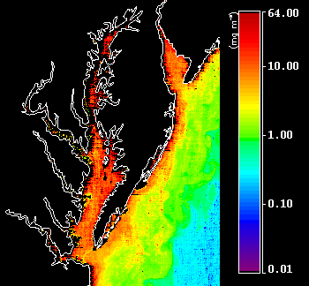
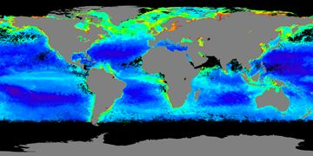
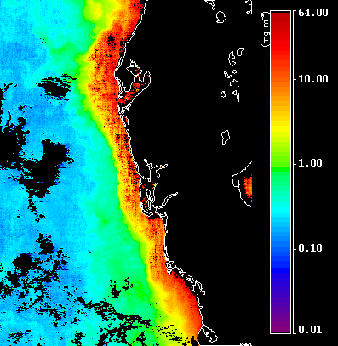

Chlorophyll Global and Regional Maps
SeaWiFS, July 2006
MODIS, NE and Florida coasts

Slide 13
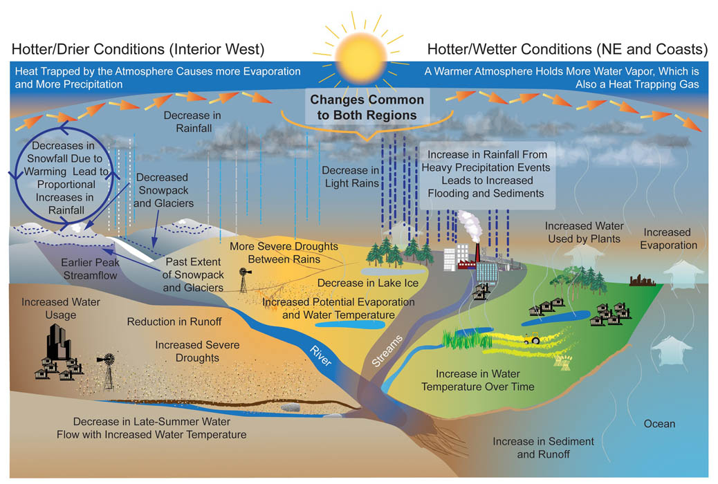
Impacts of Climate Change on the coastal areas

Slide 14
Science Goals (contd…)
Satellite coastal retrievals are challenged because:
Compared to relatively clean open ocean waters & atmospheres, coastal waters are much more complex with increased mineral and organic constituents caused by both natural & anthropogenic impacts
– river outflows, run-offs, sewage
Coastal atmospheres contain finer mode aerosols that require different atmospheric corrections than those for open ocean
Our projects designed to respond to these problems and to achieve improved and practically useful satellite retrievals of coastal IOPs and water quality
Algae
Algae
CDOM
Minerals

Slide 15
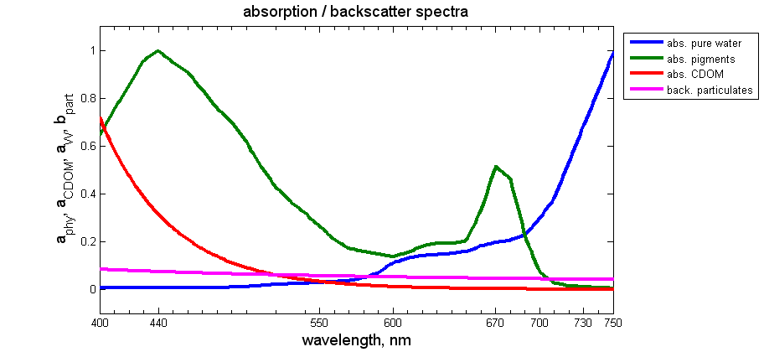
Absorption/Backscatter features
1- Chlorophyll absorption can be probed effectively using 440-570 band ratios
2- In presence of TSS and CDOM, Blue-Green ratios are contaminated.
3- Red-NIR algorithms are much less sensitive to TSS, CDOM.
4- The 670-710 channels effectively probe the ChL absorption feature and the
730 channel effectively calculates the backscatter since water abs dominates

Slide 16
Impacts of Climate Change on the Occurrence of
Harmful Algal Blooms (HABs)
Climate change is predicted to change many environmental conditions that could affect the natural properties of fresh and marine waters.
Changes in these factors could favor the growth of harmful algal blooms and habitat changes such that marine HABs can invade and occur in freshwater – Great Lakes
An increase in the occurrence and intensity of harmful algal blooms may negatively impact the environment, human health, and the economy for communities across the US and around the world.
Increase in acidity – negative impacts on marine life and corals

Slide 17
Impacts of Climate Change on the Occurrence of
Harmful Algal Blooms (HABs)
An increase in the frequency, severity and geographic distribution of HABs has been observed worldwide.
Recent research suggests that the impacts of climate change may promote the growth and dominance of harmful algal blooms through a variety of mechanisms including:
    Warmer water temperatures
    Changes in salinity
    Increases in atmospheric carbon dioxide concentrations
    Changes in rainfall patterns
    Intensifying of coastal upwelling
    Sea level rise

Slide 18
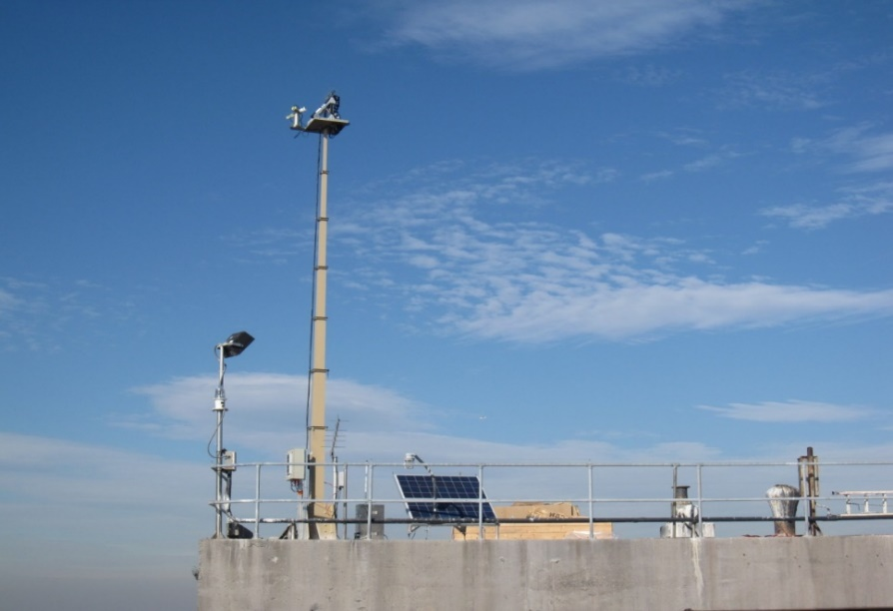
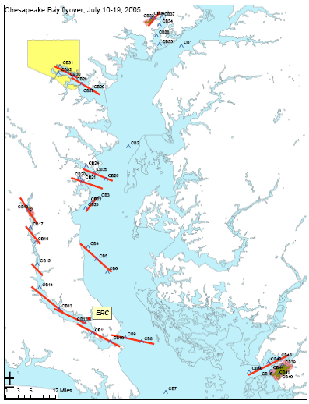
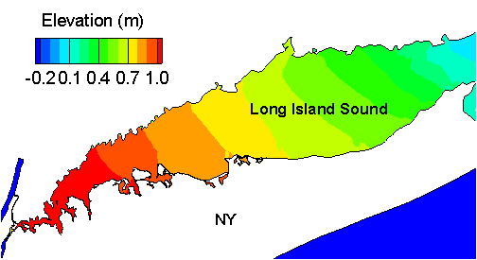
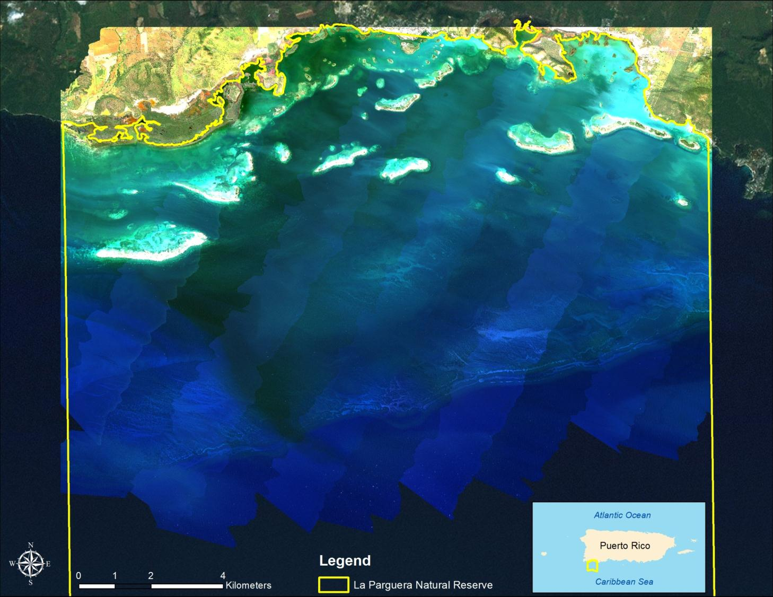
Theme IV Projects
Instrument Panel
Project 1 Validation of ocean color satellite data –in pqarticular for coastal waters
Retractable Instrument
Tower
12 meters
Project 2 Development and improvement of algorithms.
Project 3 Hydrodynamic modeling for coastal waters
Project 4 Hyperspectral Remote Sensing of Shallow Coastal Environments (UPRM)

Slide 19
Project 1: VIIRS validations using Long Island Sound Coastal Observatory (LISCO)
Provides continuous flow of data for AERONET Ocean Color Network and VIIRS cal/Val and assessments of uncertainties
Novel approach for absolute calibration of Ocean Color satellites provides check for consistency of on-board calibration facilities, improves retrieval algorithms
-
19
Notes:
19
19

Slide 20
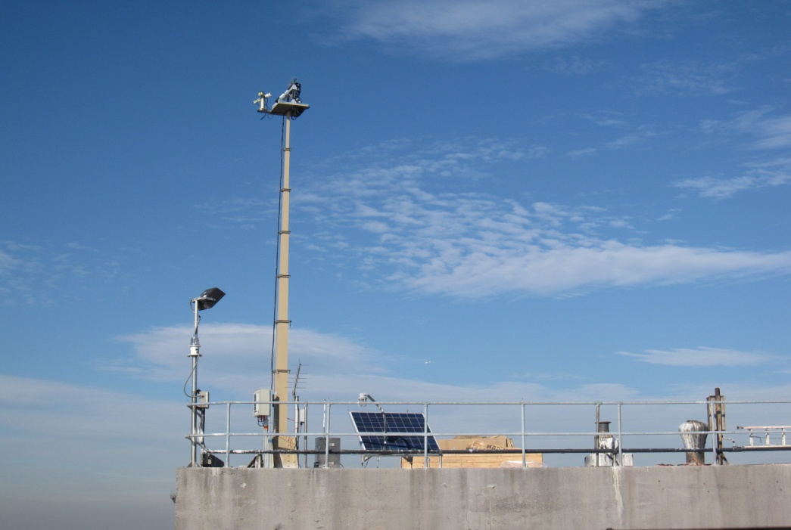
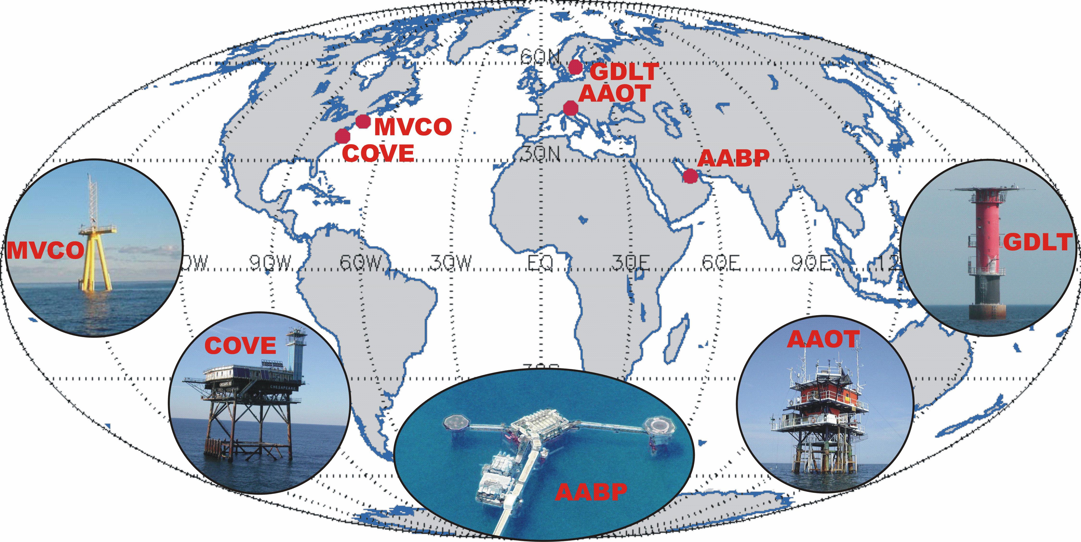
AERONET-Ocean Color
AERONET – Ocean Color: is a sub-network of the Aerosol Robotic Network (AERONET), relying on modified sun-photometers to support ocean color validation activities with highly consistent time-series of L_{WN}(λ) and τ_{a}(λ).
Data of the LISCO & and WaveCIS sites are used in this study.
LISCO
WaveCIS
Rationale:
Autonomous radiometers operated on fixed platforms in coastal regions;
Identical measuring systems and protocols, calibrated using a single reference source and method, and processed with the same code;
Standardized products of normalized water-leaving radiance and aerosol optical thickness.
G.Zibordi et al. A Network for Standardized Ocean Color Validation Measurements. Eos Transactions, 87: 293, 297, 2006.

Slide 21
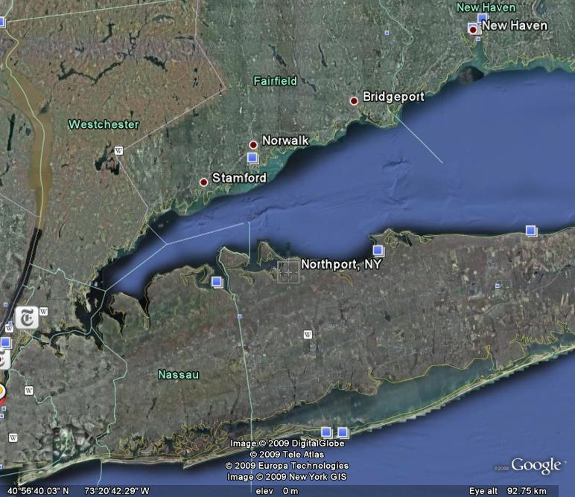

Platform: Uniquely combines collocated multispectral SeaPRISM
with hyperspectral HyperSAS instrumentations
LISCO Tower
Instrument Panel
Retractable Instrument
Tower
12 meters
21
Notes:
21
21

Slide 22
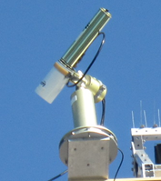
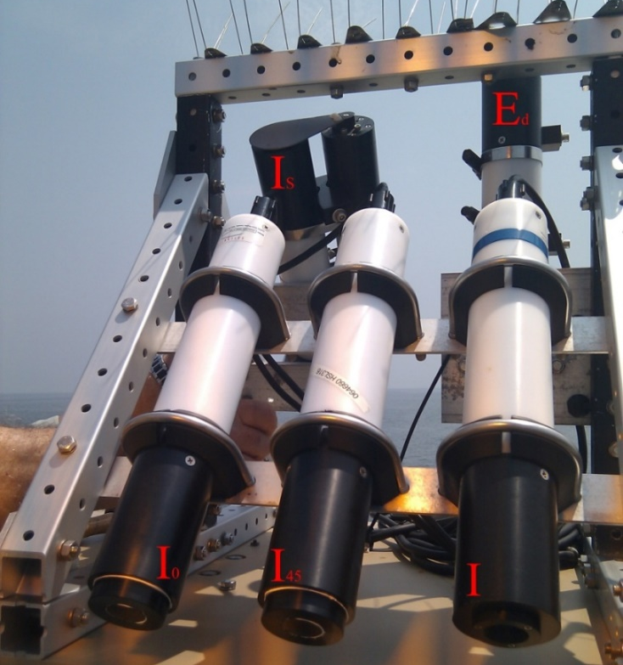
SeaPRISM instrument
LISCO Instrumentation
HyperSAS Instrument
Sea Radiance
Direct Sun Radiance and Sky Radiance
Bands: 413, 443, 490, 551, 668, 870 and 1018 nm
Sea Radiance, Sky Radiance
Downwelling Irradiance
Linear Polarization measurements
Hyperspectral: 180 wavelengths [305,900] nm
Data acquisition every 30 minutes for high time resolution time series
22
Notes:
22
22

Slide 23
Technical Differences between HyperSAS and SeaPRISM
Two Geometrical Configurations
Instrument Set Up Looking Down on Instruments
HyperSAS
SeaPRISM
Instrument Panel

Slide 24
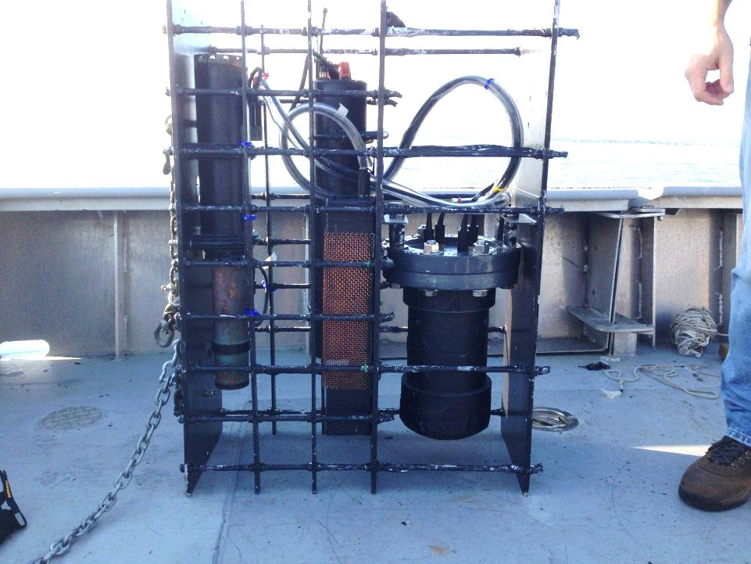
Deployment of Water Quality Monitor (WQM) at LISCO and field campaign in the area
Measure: temperature, salinity, depth, dissolved oxygen, chlorophyll, turbidity and attenuation data.
Data retrieved from initial one month period deployment prove high quality.
Added to the LISCO’s comprehensive suite of instruments and will provide high quality IOP data for sensor validation as well as development of new retrieval algorithms and water quality monitoring in Long Island Sound region.
Water Quality Monitor (WQM)

Slide 25
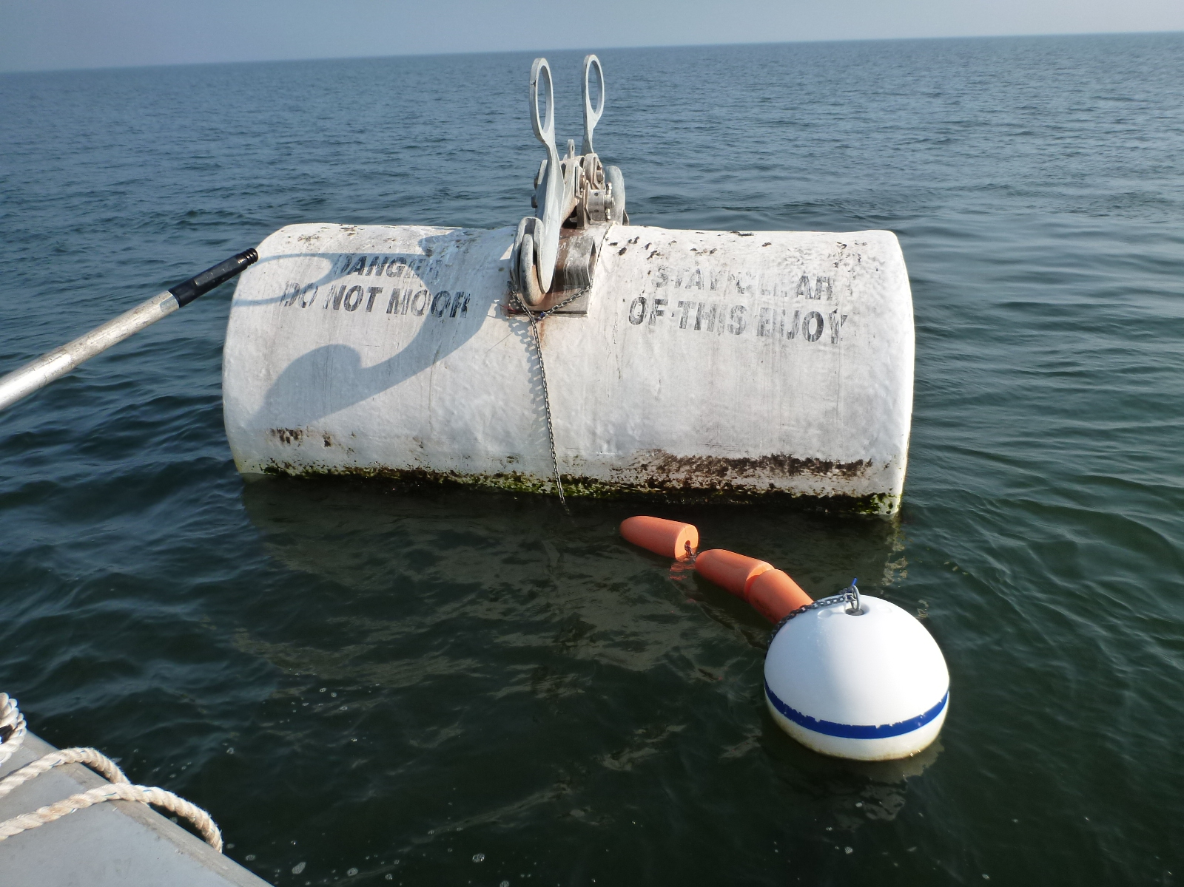

Slide 26
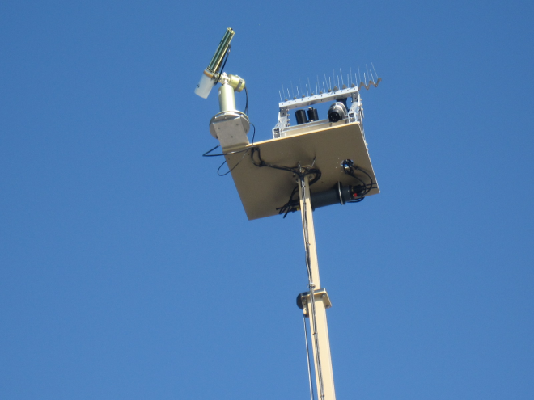
LISCO/VIIRS
  Products:
  Cal/Val
  – LISCO SeaPRISM data for NASA AERONET and AERONET Ocean Color Networks - provides continuous and critical DATA inputs for match ups and uncertainty analysis used by the NESDIS VIIRS validation team and international community, & for NOAA IDPS processing
  DATA
  hyperspectral - CREST web site,
  multispectral - NASA site.

Slide 27
Vicarious Calibration
Current and heritage satellite Ocean Color (OC) remote sensing sensors have relied on robust in-orbit radiometric calibration and validation procedures.
Among those post-launch calibration procedures, the final adjustment made to the sensor’s TOA measurements, based on in-situ surface measurements or climatology model, is known as a vicarious calibration procedure.
There are two basic kinds of vicarious calibration.
The first one is usually referred to as the (system) vicarious calibration procedure. In that procedure, calibration coefficients are obtained by forcing satellite-derived water-leaving radiances to agree with in-situ ones, and this approach is traditionally employed in the vicarious gain derivations of the current ocean color data processing.
The second procedure, which is referred to as a radiometric vicarious calibration, consists of simulating the TOA signal that the sensor should measure under certain conditions, and to compare it to the measured signal.

Slide 28
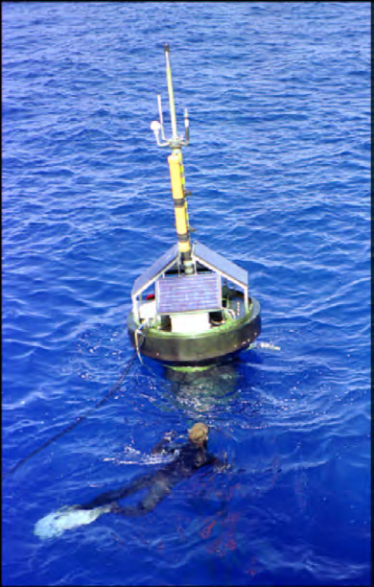
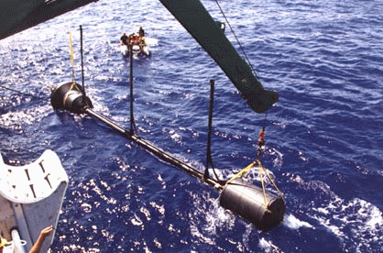
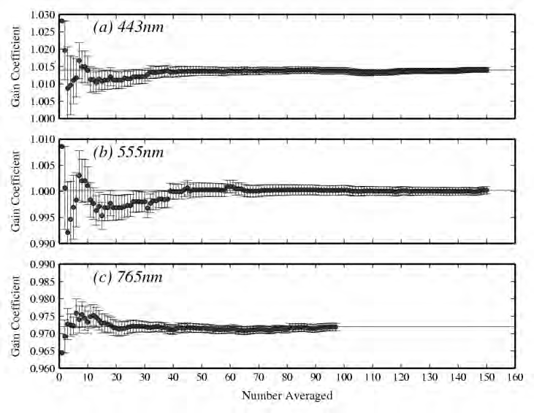
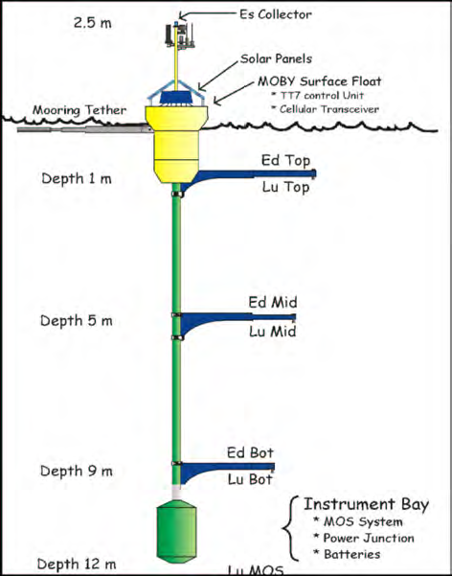
MOBY – Marine Optical Buoy
McClain, 2013

Slide 29

Above Water Signal decomposition
Novel approach using AERONET measurements & radiative transfer simulations of complete cycle of TOA-Water-TOA ocean atmosphere system provides absolute calibration of Ocean Color satellites and check for consistency of on-board calibration facilities and improves retrieval algorithms
Sun glint radiance
L_{i}
Total radiance
Sky radiance
L_{T} = L_{w} + ρ(W) L_{i} + L_{g}
Sun
θ
Water leaving radiance
θ
Sea surface reflectance factor
L_{i}
L_{w}

Slide 30
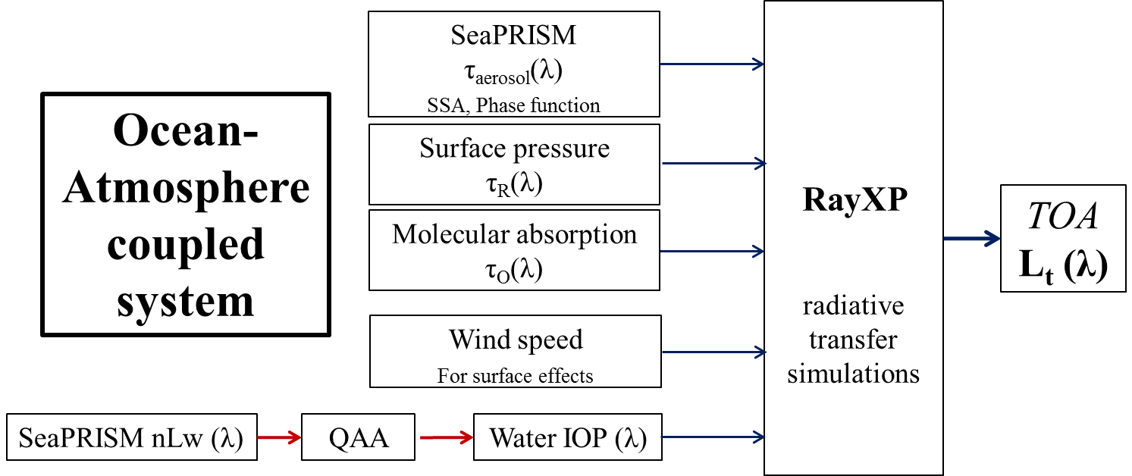
Methodology
TOA – Ocean - TOA

Slide 31
AERONET-OC sites (shows reasonable agreement for in-situ-satellite data, suitability for cal/val)
WaveCIS
LISCO
Time series of nLw(551nm), in mW/cm²/μm/sr
WaveCIS
  particulate backscattering coefficient at 551 nm is usually around 0.01 m^{–1}.
  seasonal average of the total absorption of water body is equal to 0.31 m^{–1} at 442 nm, of which ~0.15 m⁻¹ is attributed to CDOM.
LISCO
  the particulate backscattering coefficient at 551 nm ranges from 0.01 to 0.03 m^{–1},
  the total absorption coefficient at 443 nm varies from 0.38 to 1.2 m^{–1};
  the absorption due to CDOM at 443 nm is typically close to 0.4 m^{–1} and can be as high as 1 m^{–1}.
Three-year (2011–2013) average Angstrom exponent γ (443, 870) of LISCO is 1.76, whereas it is 1.23 for WaveCIS. This implies that the aerosols over WaveCIS are dominated by coarse particles whereas the LISCO site has notable contributions from fine aerosol particles.

Slide 32
Matchup comparison between VIIRS and AERONET-OC nLw(λ)
WaveCIS
Validation results for the two sites are very different from one another.
VIIRS nLw retrievals for LISCO location are consistently underestimated.
Negative retrievals are common for LISCO.
VIIRS retrievals for WaveCIS location are reasonably accurate (i.e no bias).
Water leaving radiance location dependent, ie atmospheric correction inadequate (aerosol parameters different) LISCO-fine mode, WaveCIS –coarse)
LISCO

Slide 33
In-situ & Satellite Data Used in RT Simulations
In-situ data
  All input AERONET-OC data used in this study are level 1.5 data.
  AERONET-OC data to the RT simulations are selected from the measurements made within a ±2h time window of the satellite overpass time of the locations of the sites.
Satellite data
  NASA VIIRS data
    Pseudo Level 1 VIIRS images of the LISCO and WaveCIS locations have been obtained for two years (January 2012 to December 2013) period from NASA OBPG ocean color website.
    Then, SeaDAS software version 7.0.2 package in order to generate the fully calibrated and geo-located level 2 data.
  IDPS VIIRS data
    VIIRS SDR data of IDPS processing is obtained from NOAA NESDIS. They are completely calibrated and geo-located at the SDR level & do not require additional processing.
  MODIS data
    MODIS level 1 collection 6 images are acquired from the NASA Level 1 and Atmosphere Distribution System (LAADS). These data are also fully calibrated and geo-located.
Note: Comparison between the NASA and IDPS VIIRS L_{t} data exhibits almost perfect correlation at every wavelength but slightly time dependent discrepancy (1 – 3%) in terms of magnitude. For consistency purpose, we used only the NASA VIIRS data for all analyses in this study.

Slide 34
Matchup comparisons between the simulated and VIIRS L_{t} (λ)
WaveCIS
LISCO
Excellent correlations with the overall R values close to 1 are observed for both sites.
Spectral variation ranges of simulated and VIIRS L_{t} (λ) are the same.
Regression lines for the comparisons are very close to 1:1 diagonals: simulated L_{t} (λ) data are spectrally and magnitude wise consistent with those of measured (i.e. VIIRS).

Slide 35
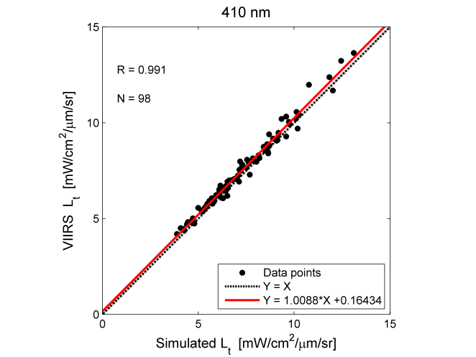
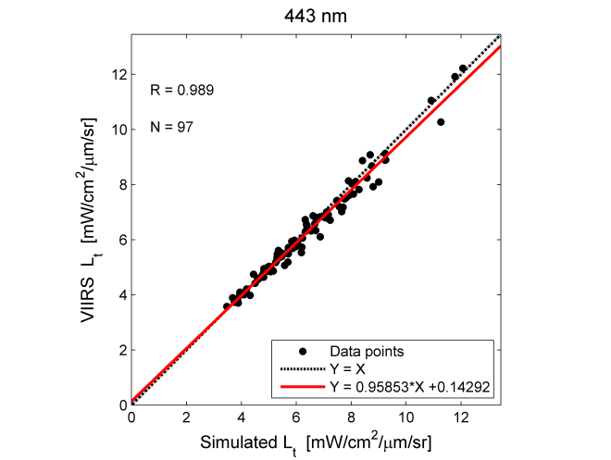
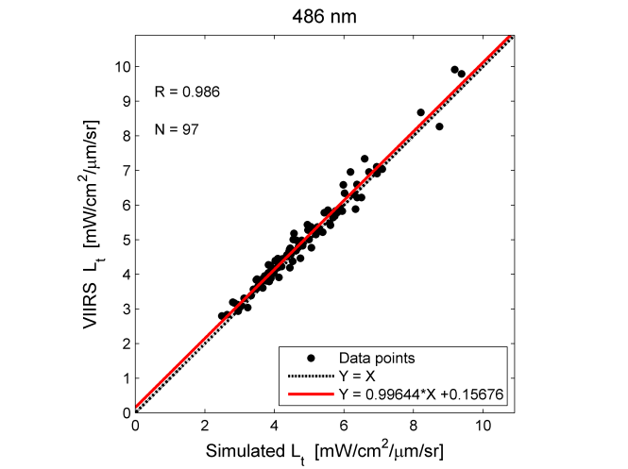
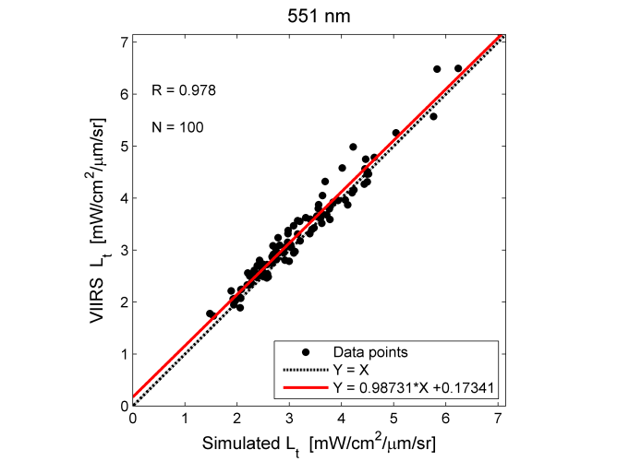
Matchup comparisons between the simulated and VIIRS L_{t} (λ) at each wavelength (Blue & Green parts of the spectrum)
Excellent correlations with the overall R values close to 1 are observed at every wavelengths.
Variation ranges of simulated and VIIRS L_{t} are the same.
Regression lines for the comparisons are very close to 1:1 diagonals.
These observations underscore that the simulated dataset is suitable for making assessments of the radiometric accuracy and stability of the Satellite Ocean Color sensors in blue and green wavelengths.

Slide 36
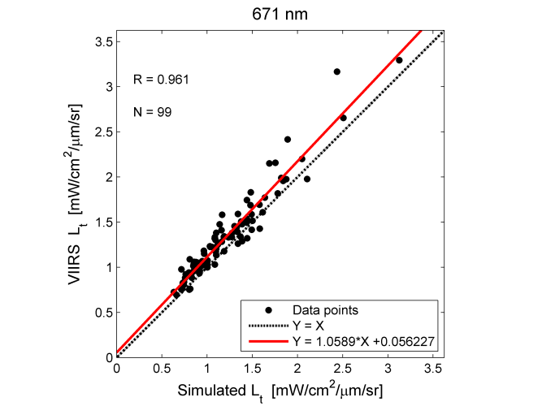
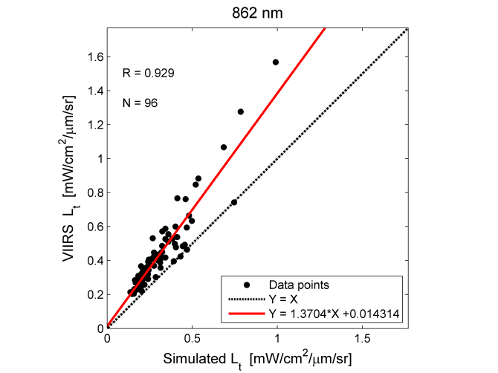
Matchup comparisons between the simulated and VIIRS L_{t} (λ) at each wavelength (Red & NIR parts of the spectrum)
Different story emerges for Red and NIR wavelengths.
Regression lines for the comparisons significantly deviate from 1:1 diagonals.
Simulated data underestimate ~10% & ~30% respectively at 671 and 862 nm wavelengths.
However, matchup points mostly concentrate along the regression lines indicating that measured TOA L_{t}(λ) are well characterized by the simulated values at every wavelengths.
Excellent correlations are also observed at both wavelengths.
This observed discrepancy between the simulated and VIIRS data will be further scrutinized in next few slides.

Slide 37
Matchup comparisons between the simulated and MODIS L_{t} (λ) at WaveCIS
Unlike VIIRS, the uncertainties between MODIS and simulated L_{t} are higher at every wavelength.
Correlations for the comparisons at 412 – 486 nm wavelengths are moderately high with their R values greater than or equal to 0.9.
Only modest correlation is achieved for the comparisons at 551, 667 & 869 nm (R values are 0.85, 0.78 & 0.75 respectively).
This can be largely explained by the MODIS’s lower 1 km nadir nominal resolution, compared to VIIRS’s 750m. For a 3 x 3 pixel box, MODIS data is averaged over roughly the twice of the area that VIIRS will cover with the same approach, thus comparisons are affected by the spatial variations within the region of interest.
However, overall consistency between simulated and MODIS data can be readily observed through the regression line between them which is very close to 1:1 diagonal

Slide 38
Derivation of the radiometric vicarious calibration gain factors
simulated
satellite
For VIIRS three separate sets of g_{c}(λ) derived:
  one set from combined match-up points for the LISCO and WaveCIS sites,
  another two derived using match-up points for each site separately.
The g_{c} values derived for both VIIRS MODIS for blue and green wavelengths are within typical vicarious adjustment range.
For the 671, 745 and 862 nm channels of VIIRS, the g_{c} values significantly deviate from the typical vicarious adjustment range.
Such large deviations also exist for MODIS in NIR channels.
In the vicarious calibration study by Melin and Zibordi* for MODIS and SeaWiFS sensors based on the data from the AAOT AERONET-OC site but with a different methodology, similar trend is observed in Red and NIR.
VIIRS
λ | 410 | 443 | 486 | 551 | 671 | 745 | 862
N for All | 80 | 77 | 74 | 74 | 76 | 75 | 76
Current MOBY | 0.9605 | 1.0019 | 1.0078 | 0.9724 | 1.0146 | 1.0389 | 1.0
WaveCIS | 0.9653 | 1.0118 | 0.9693 | 0.9478 | 0.8917 | 0.8538 | 0.7075
STD | 0.0191 | 0.0234 | 0.0277 | 0.0385 | 0.0560 | 0.1069 | 0.0774
LISCO | 0.967 | 1.0171 | 0.976 | 0.9605 | 0.9123 | 0.8682 | 0.6998
STD | 0.0211 | 0.0248 | 0.0288 | 0.0354 | 0.0413 | 0.0968 | 0.0505
All (LISCO and WaveCIS) | 0.9658 | 1.0135 | 0.9715 | 0.9525 | 0.901 | 0.8590 | 0.7009
STD | 0.0193 | 0.0238 | 0.0281 | 0.0376 | 0.0517 | 0.1031 | 0.0689
MODIS
λ | 412 | 443 | 488 | 547 | 667 | 748 | 869
N for WaveCIS | 60 | 62 | 61 | 62 | 61 | 62 | 51
Current MOBY | 0.9731 | 0.991 | 0.9935 | 0.9994 | 0.9996 | 0.9989 | 1.0
WaveCIS | 1.0060 | 1.0179 | 1.0007 | 0.9901 | 0.9693 | 0.8444 | 0.834
STD | 0.067 | 0.082 | 0.0984 | 0.13 | 0.193 | 0.104 | 0.233
*F. Mélin and G. Zibordi, "Vicarious calibration of satellite ocean color sensors at two coastal sites," Appl. Opt. 49, 798-810 (2010).

Slide 39
Sensor | SeaWiFS | MODIS | MODIS | VIIRS | VIIRS
Site | AAOT* | AAOT* | WaveCIS | WaveCIS | LISCO
671(667) nm channels | 0.90546 | 0.9154 | 0.9693 | 0.8917 | 0.9123
745 (748) nm channels | 0.851 | 0.875 | 0.8444 | 0.854 | 0.868
862 (869) nm channels | 0.83 | 0.839 | 0.834 | 0.706 | 0.700
In the vicarious calibration study by Melin and Zibordi* for MODIS and SeaWiFS sensors based on the data from the AAOT AERONET-OC site but with a different methodology, similar trend is observed in Red and NIR.
such large discrepancies between the simulated and satellite data at red (VIIRS only) and NIR (both MODIS & VIIRS) channels cannot be entirely attributed to either our methodology or the radiometric accuracy of the sensors but these may at least partially result from the in-situ SeaPRISM aerosol retrievals at the NIR wavelengths.
Although correlations between the simulated and satellite TOA L_{t} at the red and NIR channels are high (R ≥ 0.93 for those channels), validities of the resulting g_{c} values are inconclusive at the moment, further separate study should be granted to resolve the issues.
*F. Mélin and G. Zibordi, "Vicarious calibration of satellite ocean color sensors at two coastal sites," Appl. Opt. 49, 798-810 (2010).

Slide 40
Project 2
Project 2 Development and improvement of algorithms.
Neural Network techniques for retrieval of Chl and water optical properties on the regional and global scales
New near IR algorithms – accurate estimation of Chl concentrations
Algorithms for detection of harmful algal blooms of different types
Polarization sensitive detection of in and above water light – adds fundamentally new measurement parameter for retrieving absorption /attenuation ratios & particle distributions.

Slide 41
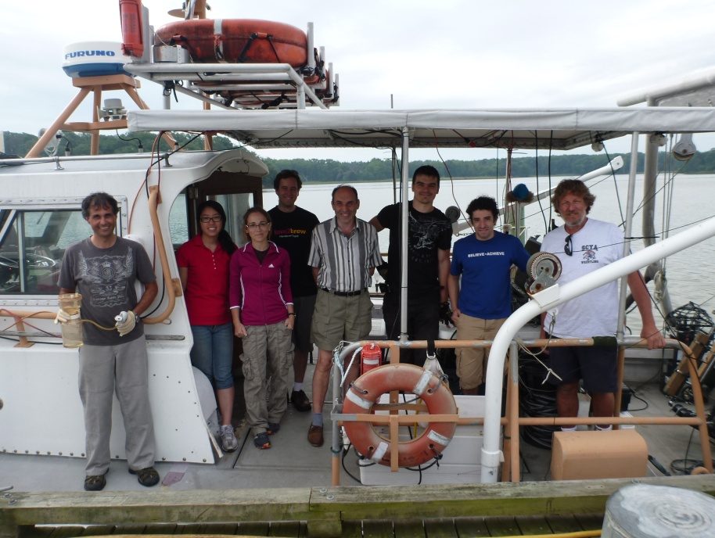
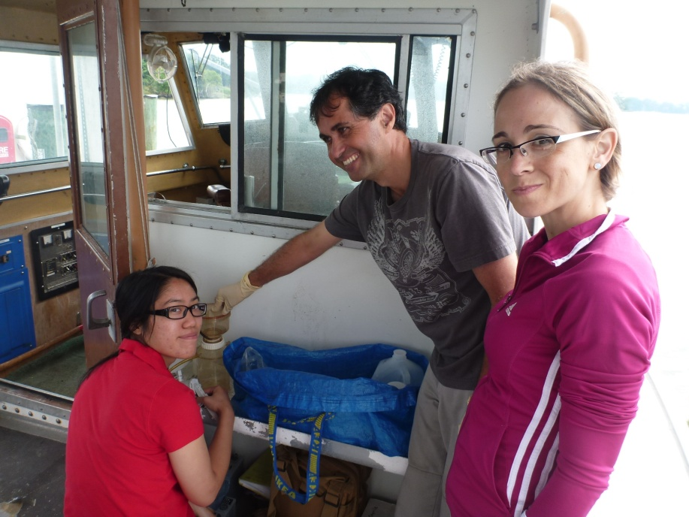
Major field campaign in Chesapeake Bay : Aug 2013
Participants: CREST, NOAA-NESDIS, NASA, U. Maryland, Columbia University
Goals: Validation of field data with satellites, collection of field data for algorithm development and validation, intercomparison of measurement techniques, development and testing of new instrumentation

Slide 42
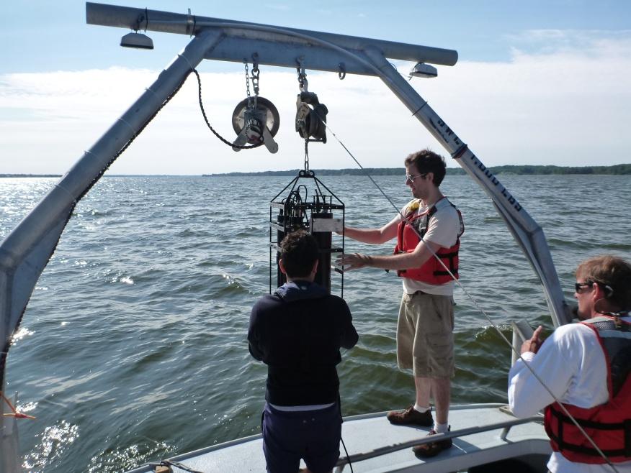
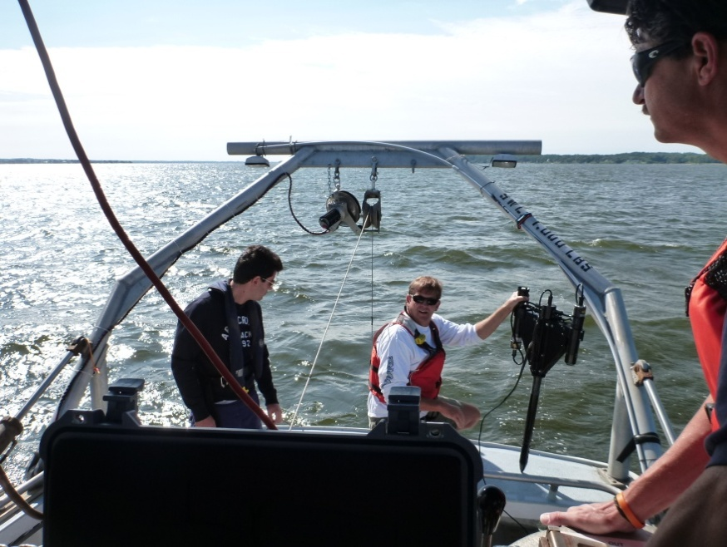
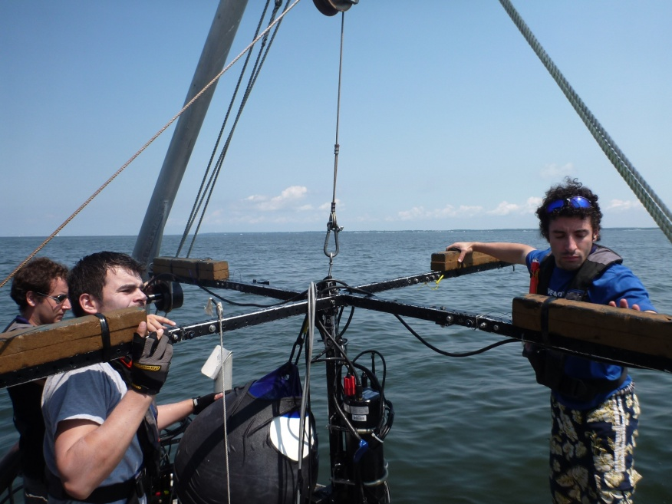
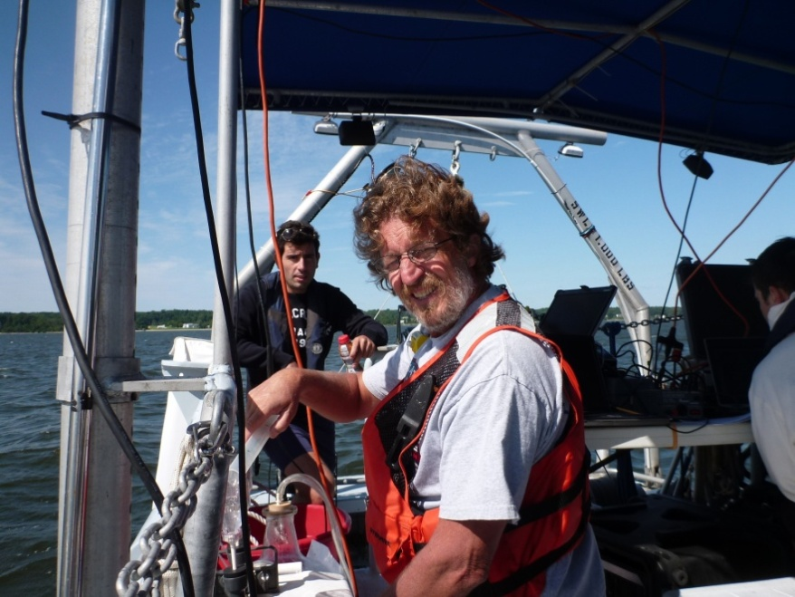
Chesapeake Bay campaign: Aug 2013
Instrumentation: in-water and above water reflectance, water optical properties, PSD, water samples, ALFA for underway measurements
IOP package
HyperPro
Polarimeter
Water samples

Slide 43
Sample stations of our Summer 2013 field Campaign (N=43)

Slide 44
Reflectance measured and modeled (using Hydrolight and WetLabs measurements) during our summer 2013 campaign

Slide 45
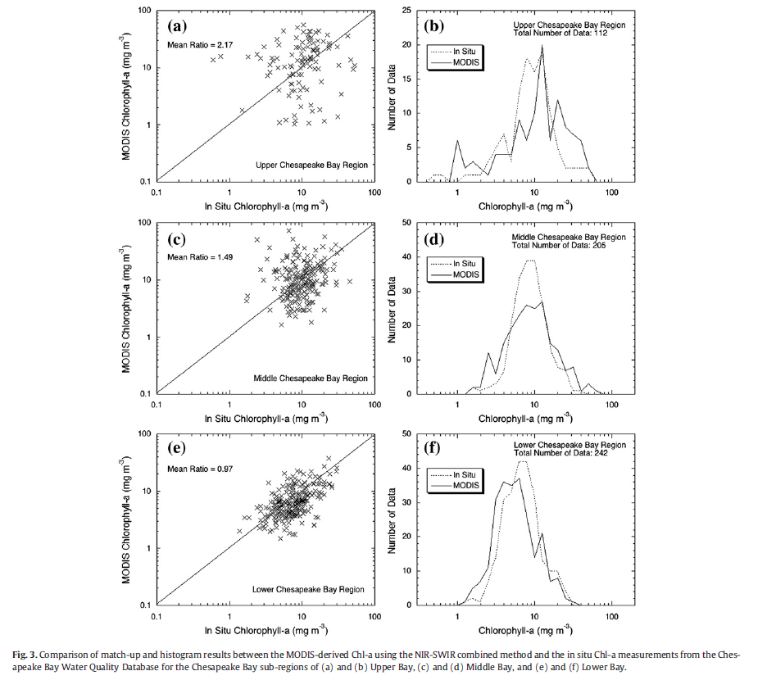
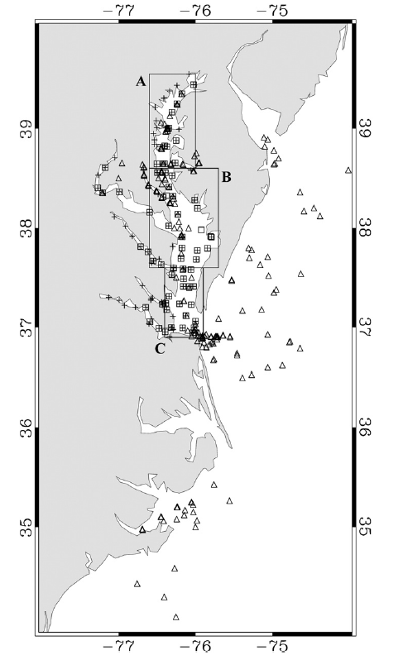
Performance of OC3M algorithm
Son et al. 2012
Our overall estimation R²<0.1

Slide 46
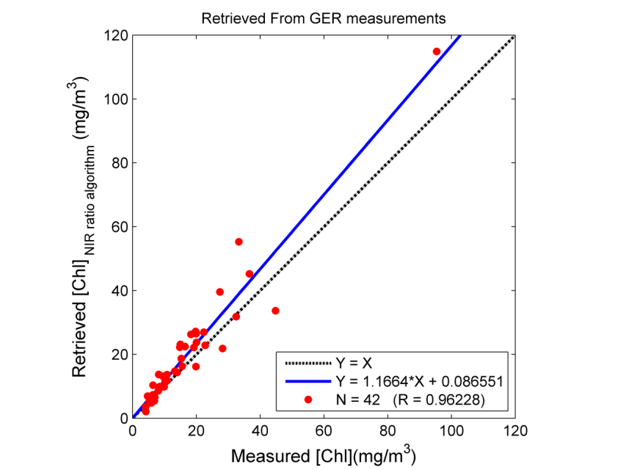
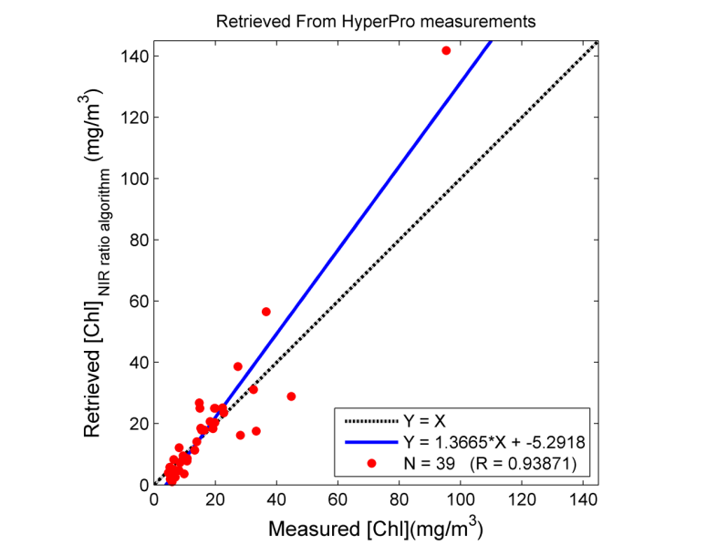
NIR/Red algorithm on field data, Chesapeake Bay
Chl, NIR/red bands ratio algorithm, Gilerson et al, 2010 (Rrs708/Rrs665)
Confirms high consistency of our field data

Slide 47
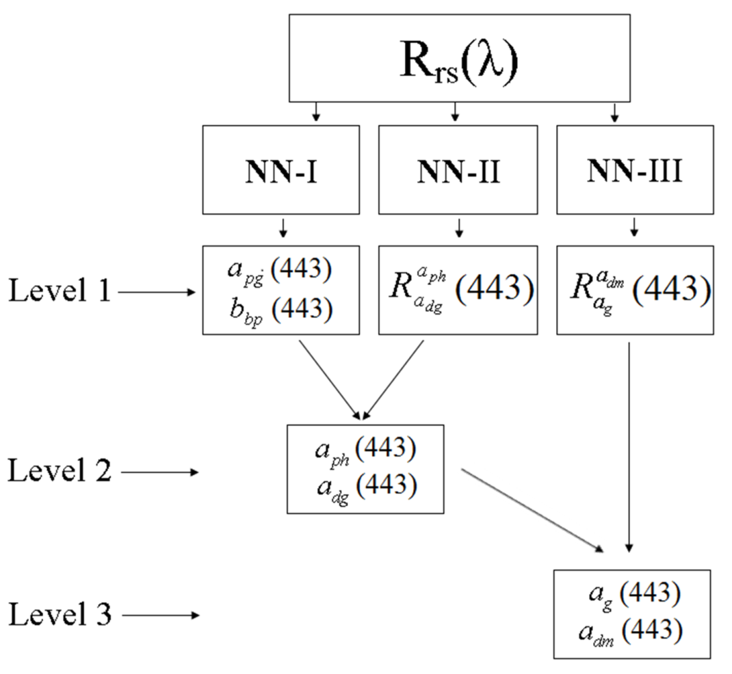
Algorithm description for retrieval of IOPs
(trained on simulated data set)
Input to the neural networks is the log₁₀ of above water Reflectance R_{rs} at the visible MODIS wavelengths 412, 443, 488, 531, 547 and 667nm
NN-I, NN-II, NN-III are one layer neural networks with 6 neurons at the hidden layer and are trained based on the simulated dataset.
Retrieved parameters
a_{pg} :the particulate and dissolved absorption coefficient
b_{bp}: particulate backscattering coefficient
a_{phy}: phytoplankton absorption coefficient a_{dm}: non-phytoplankton particulate absorption coefficient
a_{g}: dissolved absorption coefficient
Ioannou et al. 2011 & 2013

Slide 48
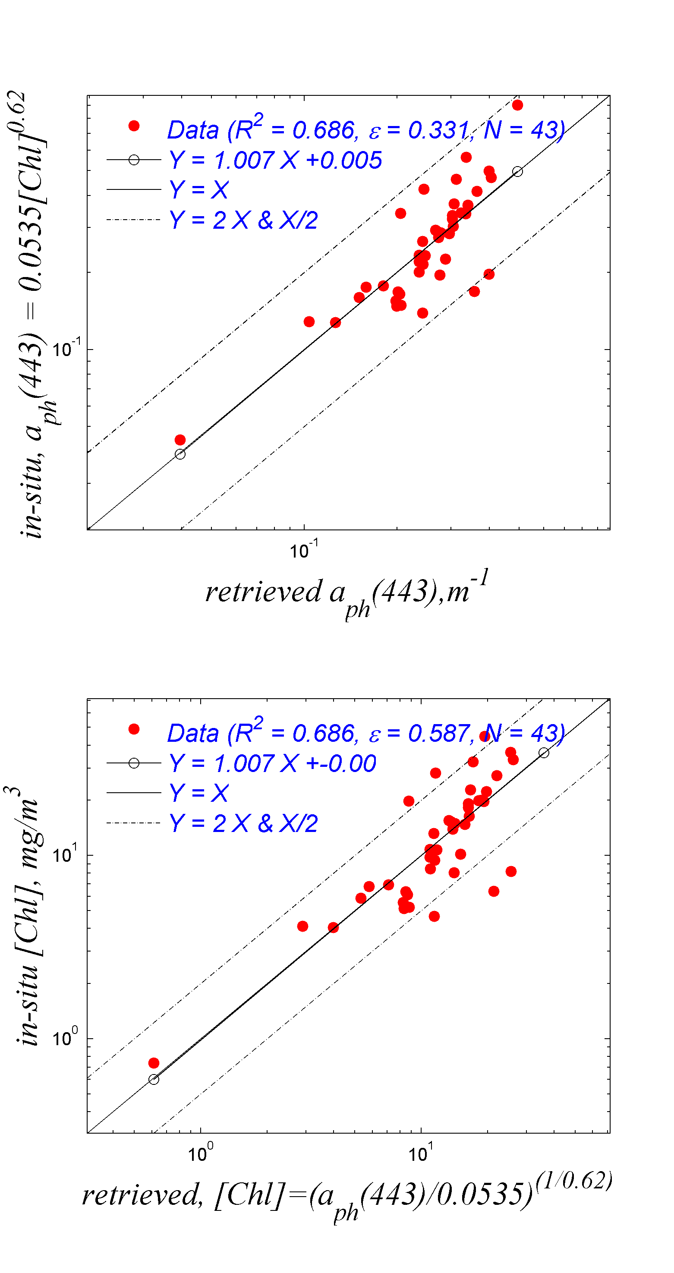
Validation of algorithms
Chl, NIR/red bands ratio algorithm,
Gilerson et al, 2010 (Rrs708/Rrs665)
Chl, Neural Network retrieval

Slide 49
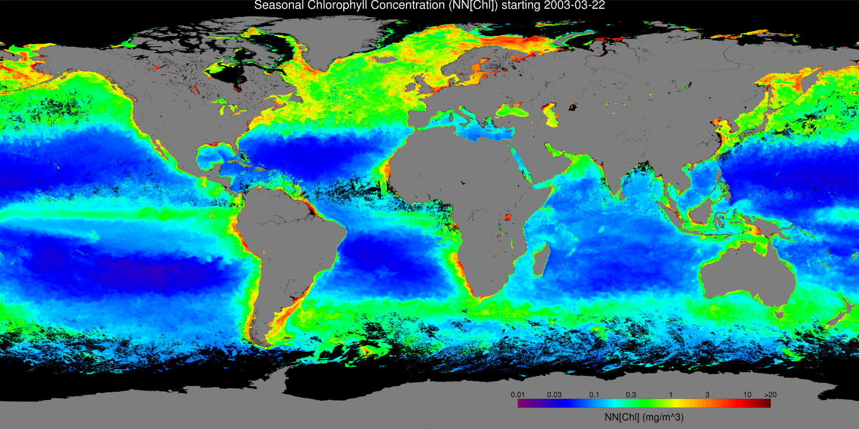

Alternative Ocean Color Algorithms - NN
Sample Seasonal [Chl], Spring 2003
Algorithm Implementation on Satellite Data- NN-[Chl], mg m⁻³

Slide 50
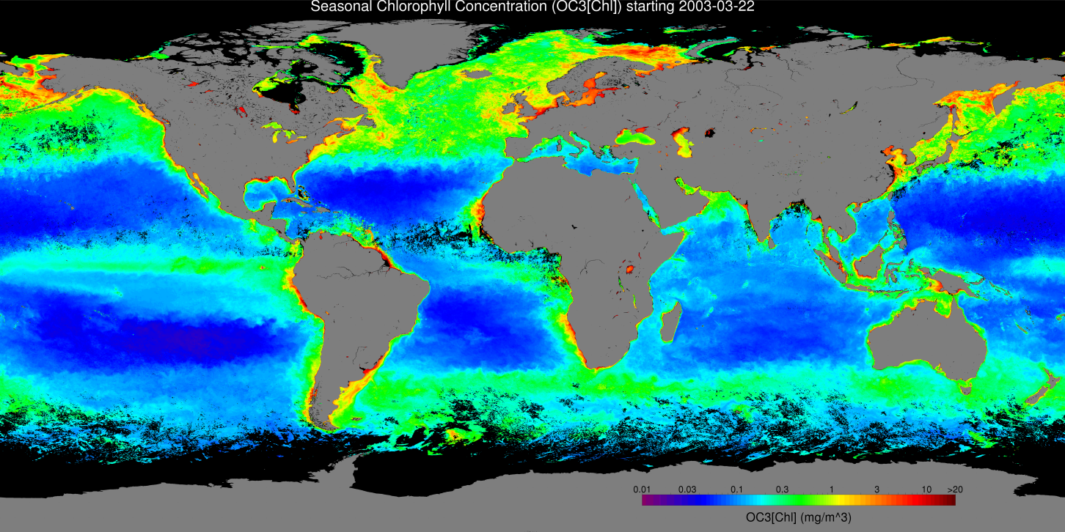
Alternative Ocean Color Algorithms - NN
Sample Seasonal [Chl], Spring 2003
Algorithm Implementation on Satellite Data- OC3-[Chl], mg m⁻³

Slide 51
Algorithm description for retrieval of IOPs
(trained on simulated data set) for HABS
Input to the neural networks is the log₁₀ of above water Reflectance R_{rs} at the visible MODIS wavelengths 412, 443, 488, 531, 547 and 667nm
NN-I, NN-II, NN-III are one layer neural networks with 6 neurons at the hidden layer and are trained based on the simulated dataset.
Retrieved parameters
a_{pg} :the particulate and dissolved absorption coefficient
b_{bp}: particulate backscattering coefficient
a_{phy}: phytoplankton absorption coefficient a_{dm}: non-phytoplankton particulate absorption coefficient
a_{g}: dissolved absorption coefficient
Ioannou et al. 2011 & 2013

Slide 52
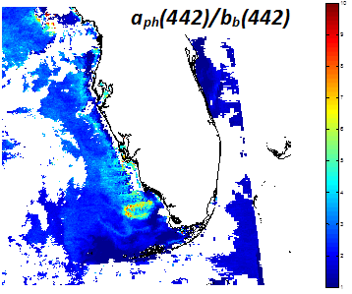
Neural Network MODIS Processed image of Nov 21 2004 –aph442/bb442

Slide 53

Neural Network MODIS Processed image of Nov 21 2004 –RBD=Rrs678-Rrs667
RBD

Slide 54


Slide 55


Slide 56
How can we use polarization characteristics of light in water?
Utilizing polarization properties of ocean and coastal waters for improved IOP retrievals
Standard remote sensing signals by definition do not contain information about full scattering b and attenuation c.
DoLP can be used to retrieve information about these parameters.
With simulations using RayXP program for fast solution of radiative transfer equation, we show further that attenuation/absorption ratio c/a can be determined from measured DoLP.
Parmeterizing relationship permits it to be used for remote sensing retrievals of absorption/attenuation ratio & particle distributions

Slide 57
c/a - DOLP relationship
Example of Retrieval process
Attenuation and scattering coefficients can be retrieved from DOP measurements
Establishing an algorithm for the retrieval process.
Inputs
DOP
PSD(ξ)
Absorption coefficient
Retrieval Algorithm
Outputs
Attenuation coefficient
Scattering coefficient

Slide 58



Validation of the polarized algorithms demonstrated in field measurements
FULL STOKES
POLARIZATION
CAMERA
DATA LOG &
STEPPER
MOTOR
THRUSTERS
HYPERSPECTRAL
RADIOMETERS
(0°, 45°, 90°, LH CP)
135°
Integrated polarimeter-camera system developed by us and used in conjunction with HyperSAS-POL (LISCO) & WQM
Matchups between HyperSAS –POL at LISCO and WQM in water

Slide 59
THANK YOU

